Slide 1
Microbial physiology. Microbial metabolism,Bioenergetics

Slide 2
3. Electron Transport System
Occurs within the cell membrane of Bacteria
Chemiosomotic Model of Mitchell
34 ATP

Slide 3
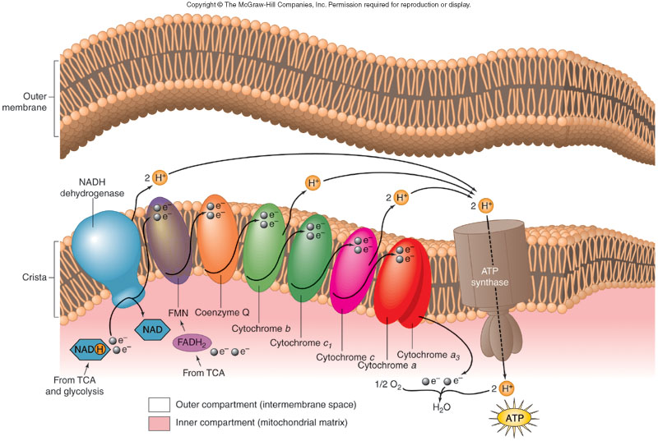
Electron transport system

Slide 4
Anaerobic respiration
Utilizes same Three coupled pathways as Aerobic Respiration Used as an alternative to aerobic respiration
Final electron acceptor something other than oxygen:
NO₃⁻ : Pseudomonas, Bacillus.
SO₄⁻: Desulfovibrio
CO₃⁻: methanogens
In Facultative organisms
In Obligate anaerobes
Lower production of ATP because only part of the TCA
cycle and the electron transport chain operate.

Slide 5
Fermentation
Incomplete oxidation of glucose or other carbohydrates in the absence of oxygen
Uses organic compounds as terminal electron acceptors
Effect - a small amount of ATP
Production of ethyl alcohol by yeasts acting on glucose
Formation of acid, gas & other products by the action of various bacteria on pyruvic acid

Slide 6
Metabolic strategies
 | Pathways involved | Final e- acceptor | ATP yield
Aerobic respiration | Glycolysis, TCA, ET | O₂ | 38
Anaerobic respiration | Glycolysis, TCA, ET | NO₃⁻, So₄⁻², CO₃⁻³ | variable
Fermentation | Glycolysis | Organic molecules | 2

Slide 7
Many pathways of metabolism are bi-directional or amphibolic
Metabolites can serve as building blocks or sources of energy
Pyruvic acid can be converted into amino acids through amination
Amino acids can be converted into energy sources through deamination
Glyceraldehyde-3-phosphate can be converted into precursors for amino acids, carbohydrates and fats

Slide 8
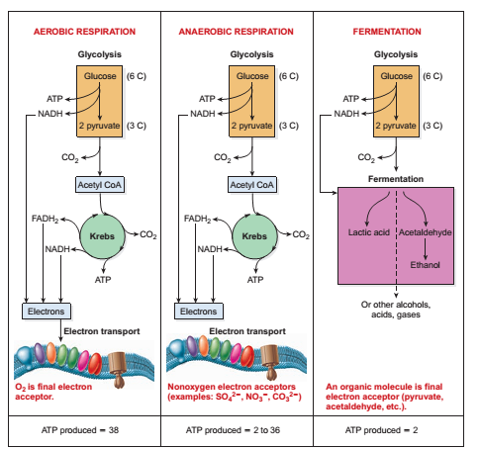
Summary of the most common pathways of glucose metabolism

Slide 9
Redox reactions
Always occur in pairs.
There is an electron donor and electron acceptor which constitute a redox pair.
Released energy can be captured to phosphorylate ADP or another compound.

Slide 10
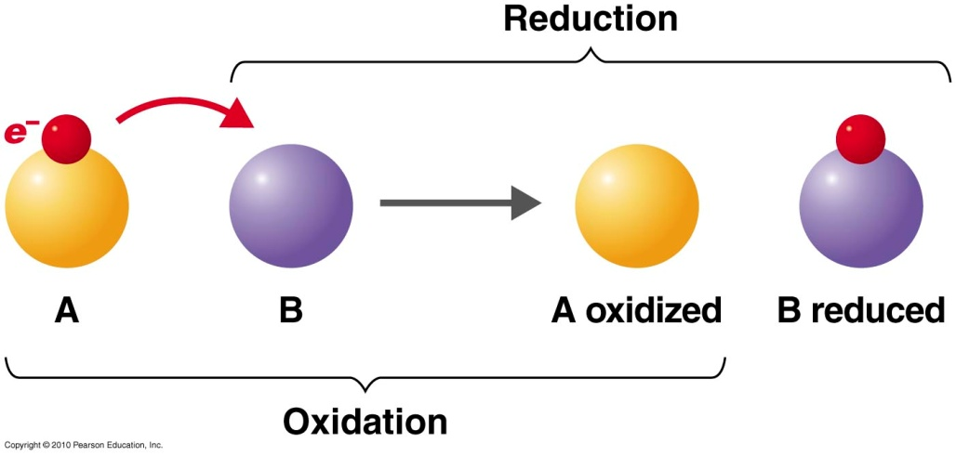
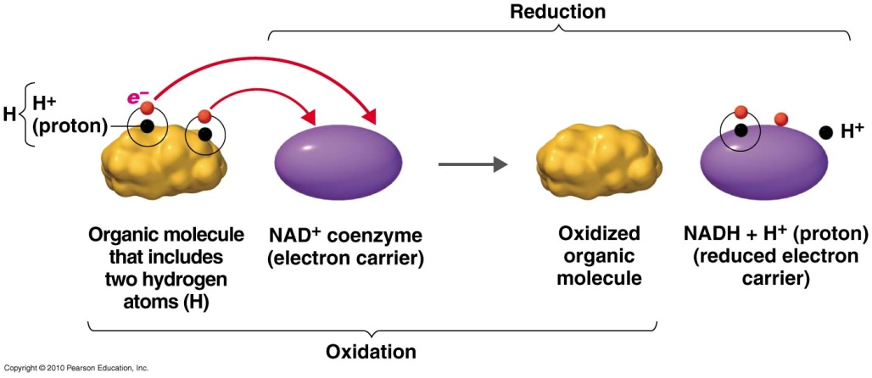
Oxidation-reduction reaction
Basic reaction
Biological reaction
: electron uptake
: electron removal

Slide 11
ATP
Three part molecule consisting of
adenine – a nitrogenous base
ribose – a 5-carbon sugar
3 phosphate groups
Removal of the terminal phosphate releases energy
Adenosine Tri Phosphate
ADP + energy + phosphate
ATP contains energy that can be easily released (high-energy or unstable energy bond)
Required for anabolic reactions

Slide 12
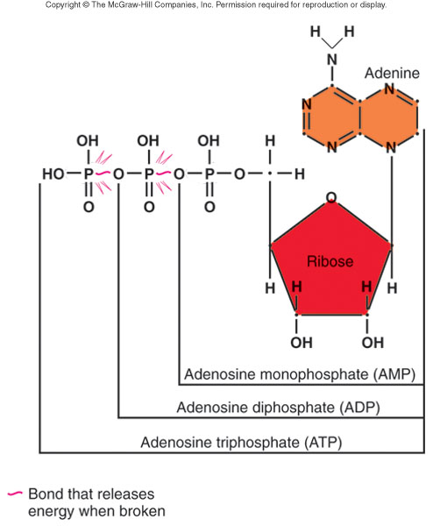
ATP

Slide 13
Formation of ATP
substrate-level phosphorylation
oxidative phosphorylation, (reduced chemicals)
Uses of ATP:
Energy for active transport
Energy for movement
Energy for synthesis of cellular components
ALL SYNTHESIS REACTIONS INVOLVE USE OF ENERGY

Slide 14
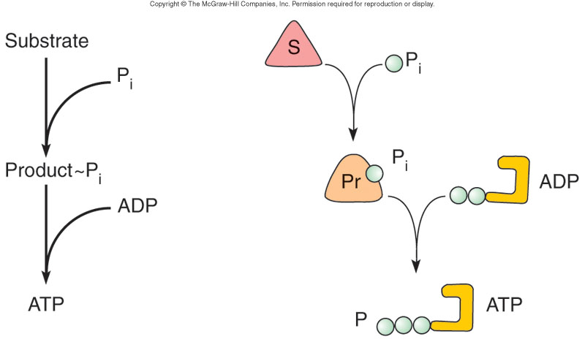
Substrate-level phosphorylation

Slide 15
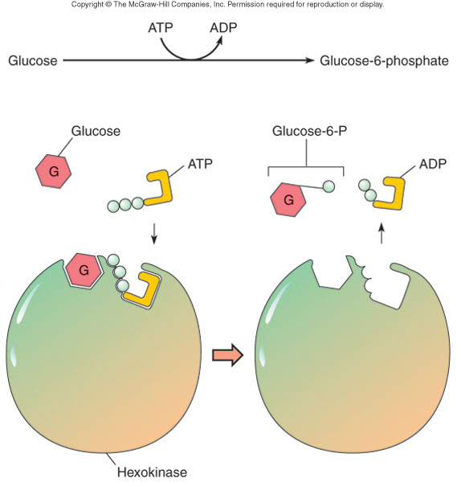
Phosphorylation of glucose by ATP

Slide 16
Lipid Metabolism
Lipids are essential to the structure and function of membranes
Lipids also function as energy reserves, which can be mobilized as sources of carbon
90% of this lipid is “triacyglycerol”
triacyglycerol ^{lipase} glycerol + 3 fatty acids
The major fatty acid metabolism is “β-oxidation”

Slide 17
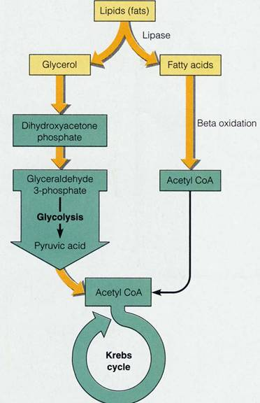
Lipid catabolism
Lipids are broken down into their constituents of glycerol and fatty acids
Glycerol is oxidised by glycolysis and the TCA cycle
Lipids are broken down to 2 carbon acyl units where they enter the TCA cycle

Slide 18
PROTEIN CATABOLISM
proteins cannot cross bacterial plasma membrane, so bacteria must produce extracellular enzymes called proteases and peptidases that break down the proteins into amino acids, which can enter the cell.
Many of the amino acids are used in building bacterial proteins, but some may also be broken down for energy. If this is the way amino acids are used, they are broken down to some form that can enter the Kreb’s cycle. These reactions include:
1. Deamination—the amino group is removed, converted to an ammonium ion, and excreted.
2. Decarboxylation—the ---COOH group is removed
3. Dehydrogenation—a hydrogen is removed
Tests for the presence of enzymes that allow various amino acids to be broken down are used in identifying bacteria in the lab.

Slide 19
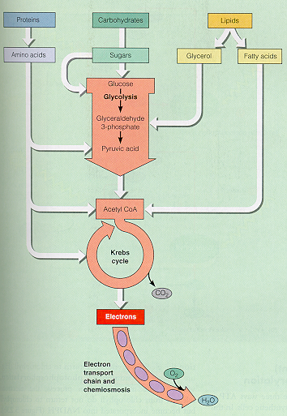
Protein Catabolism

Slide 20
